Slide 1



Welcome to iClicker Reef!

Slide 2
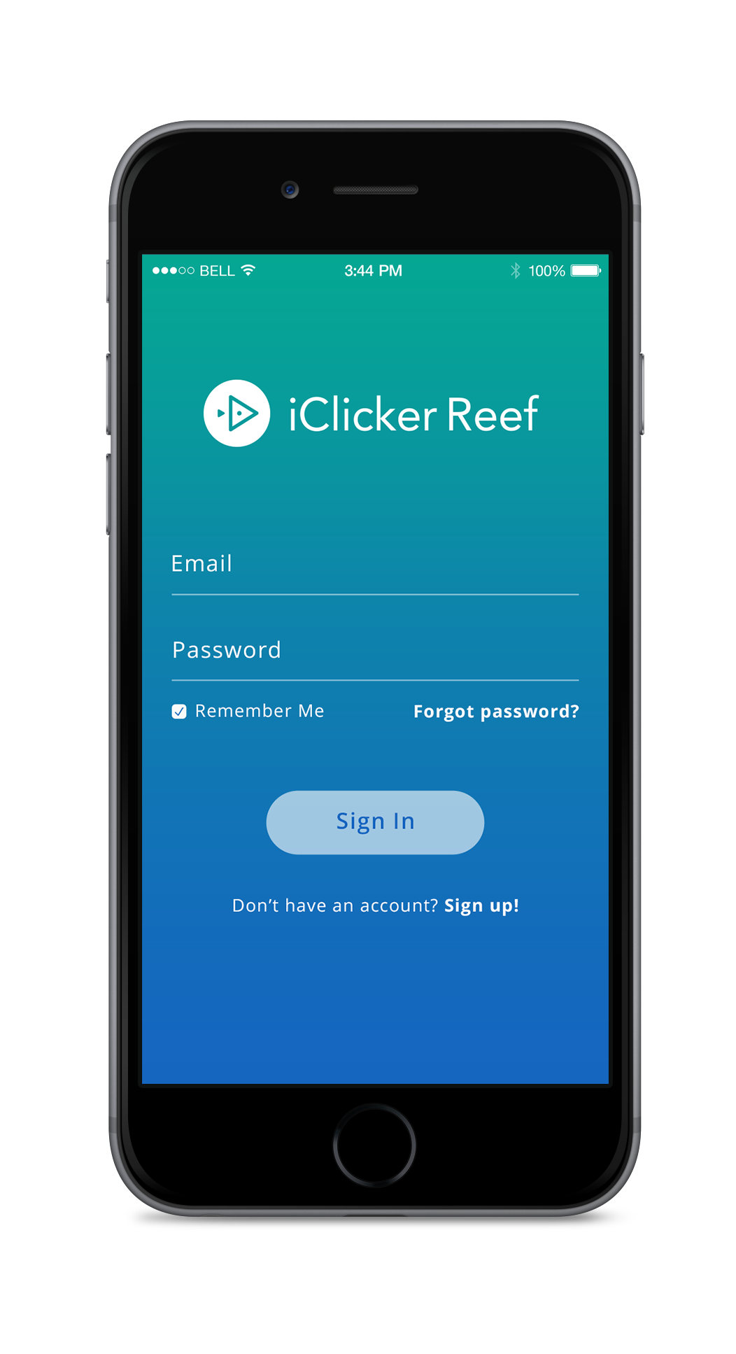
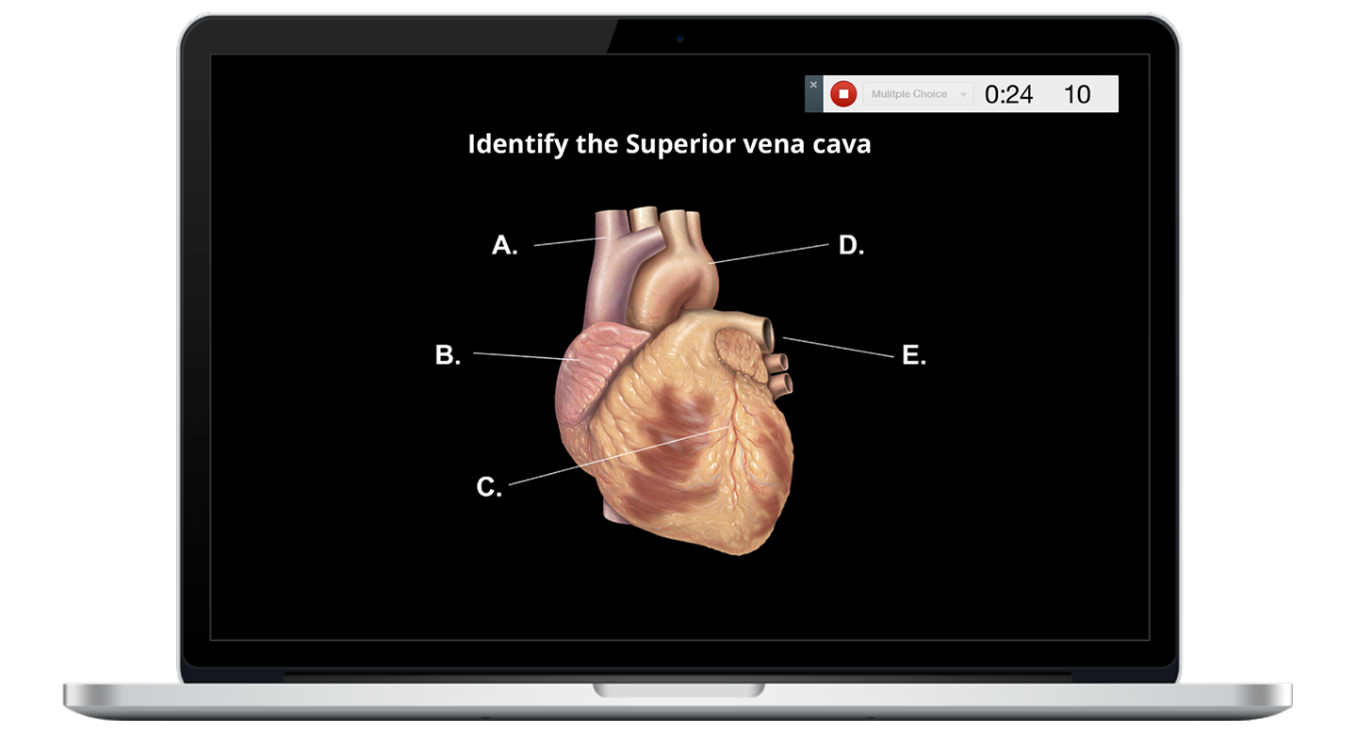
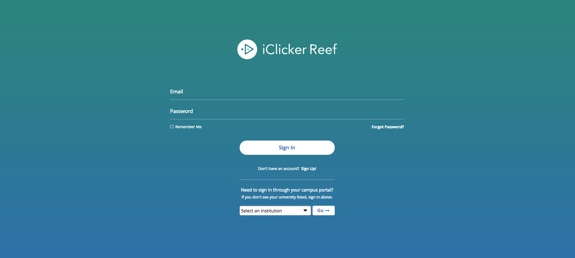
Devices Allowed in Class
You are required to bring a device to participate in my sessions during class.
You must use iClicker Reef on a smartphone, tablet or laptop
The white physical clickers are no longer supported.

Slide 3
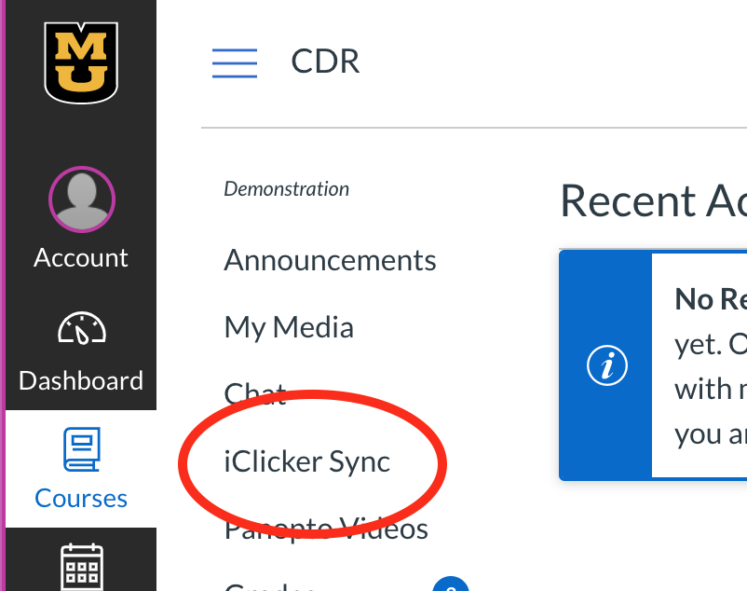
Click the iClicker Sync link in Canvas
Navigate to the iClicker Sync link in Canvas and click the link embedded there.
This will open the iClicker Reef sign-in page.

Slide 4
Create an iClicker Reef Account
You must create an iClicker Reef account to ensure your grades are counted.
Click Sign-up to create your account.
If you already have a Reef account, just sign in! Do not create and use more than one Reef account as you will only receive credit from a single account.

Slide 5
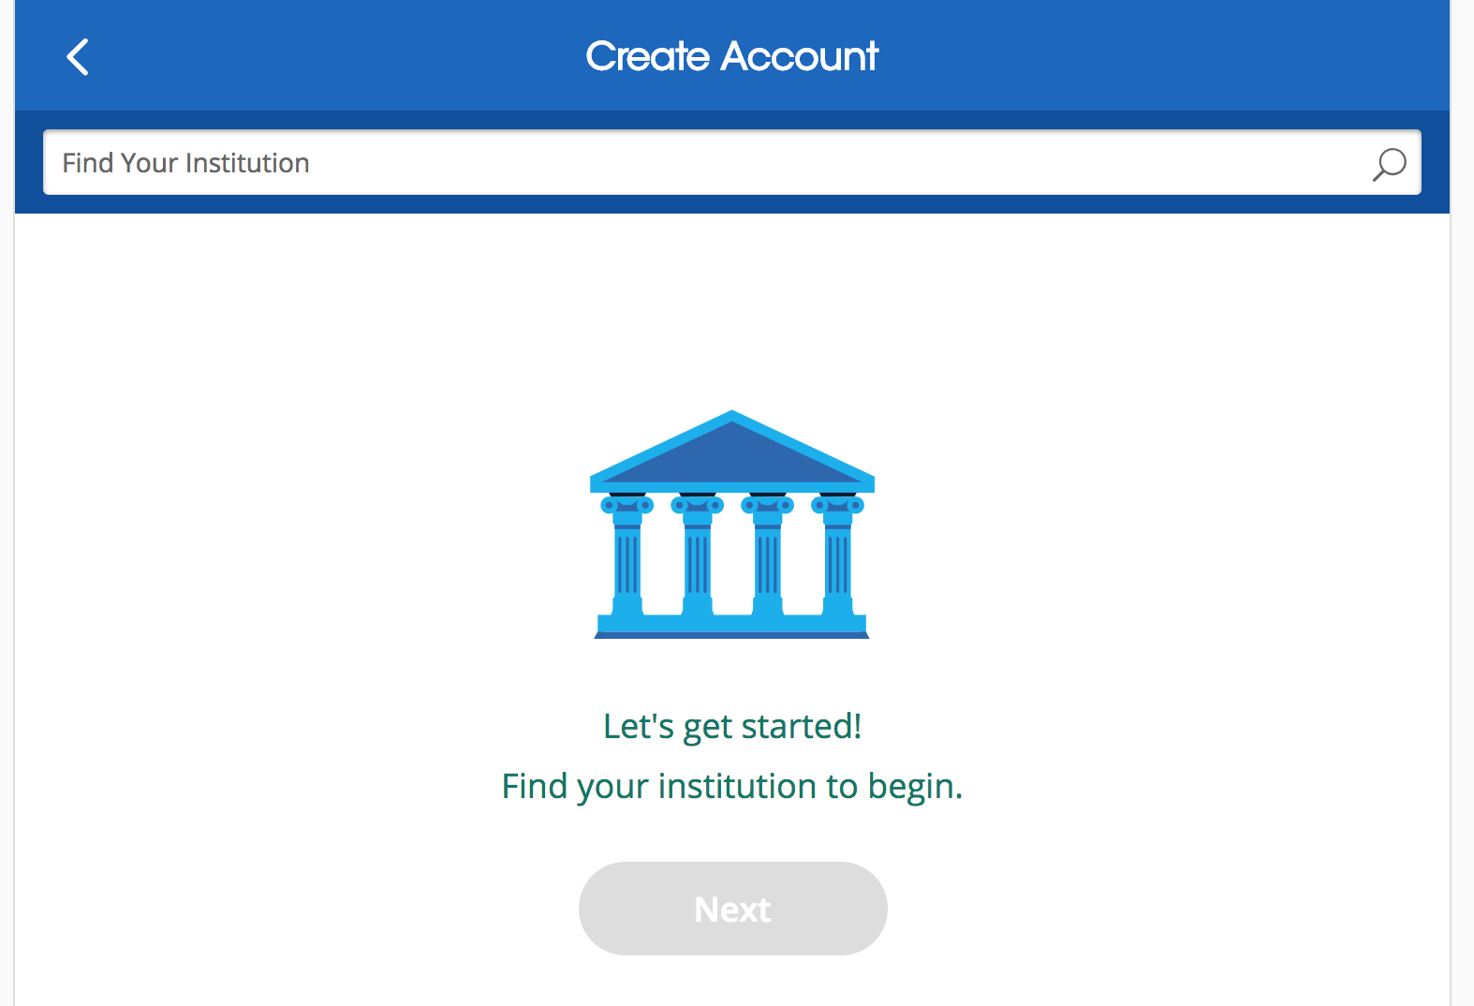
Set Default Institution
Enter University of Missouri – Columbia as your institution when creating your account.
Click Next.

Slide 6
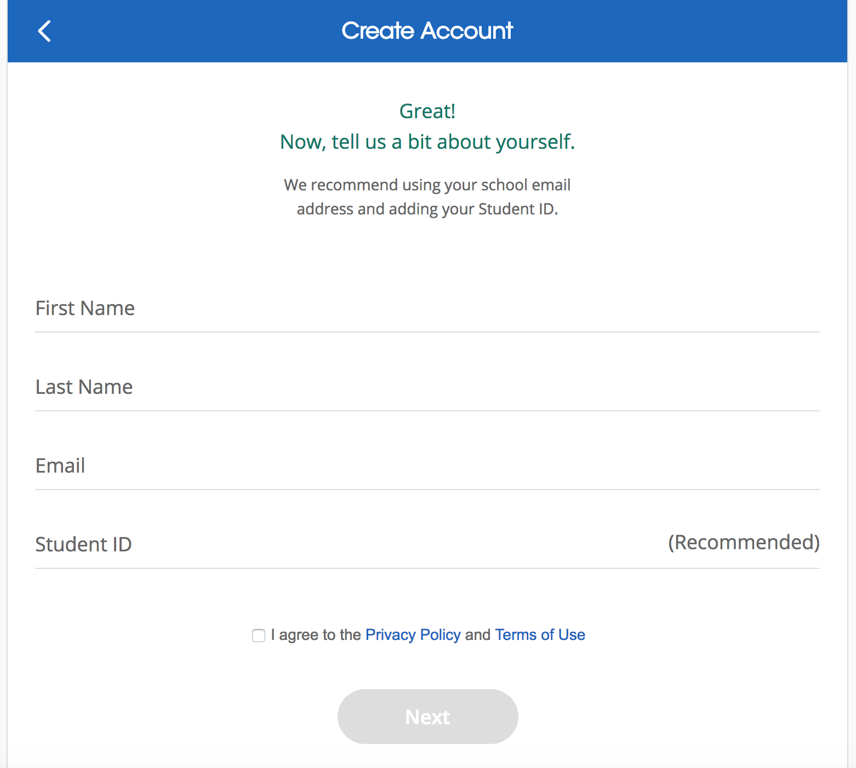
Complete your Reef Profile
On the Create Account form, fill out your
*First Name
*Last Name
*University Email
*Pawprint
Click Next.

Slide 7
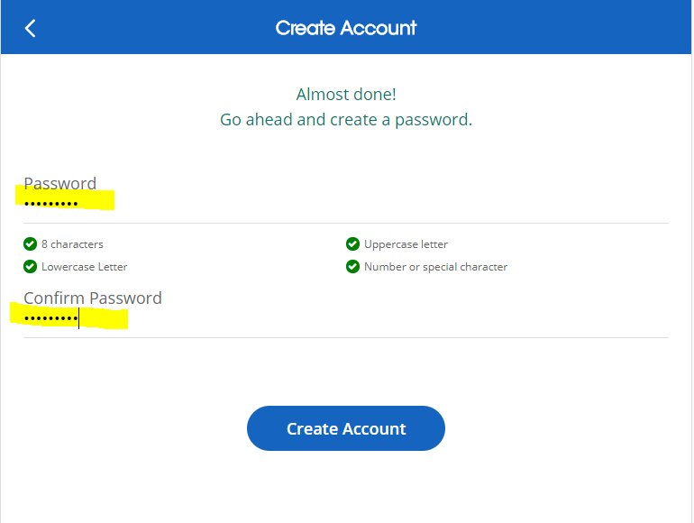
Create a password
Create and confirm your password in the two boxes on the next page.
Click Create Account.

Slide 8
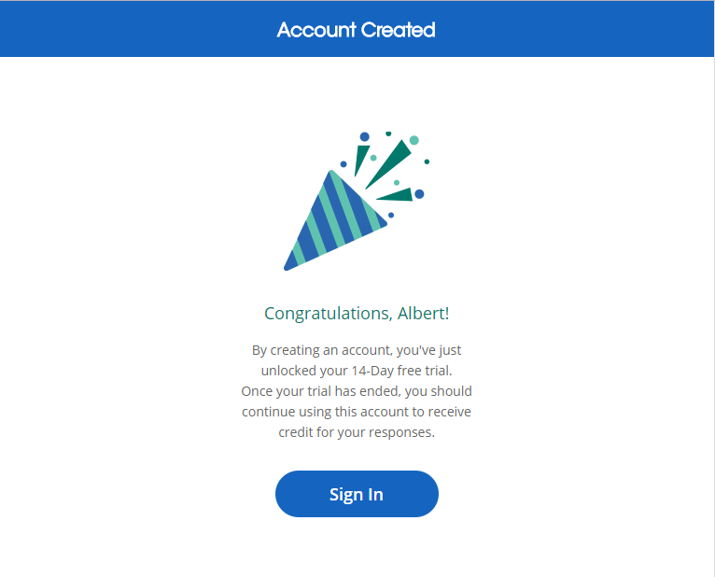
Paying for Access to Reef
The University of Missouri has purchased a site wide license for iClicker Reef. You will NOT need to purchase a subscription or pay for anything.

Slide 9
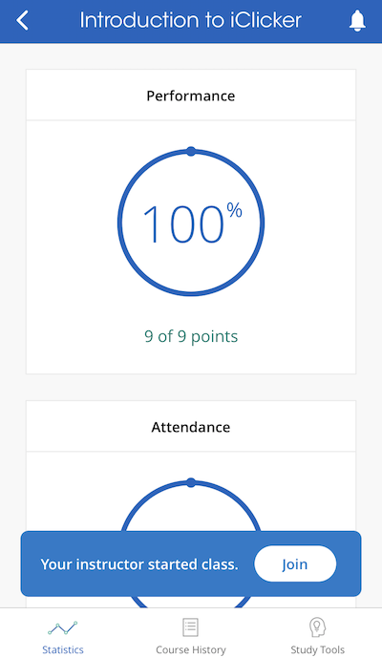
Now you’re ready to go!
I will be running [Attendance, Polling, and Quizzing] sessions in class.
When I start a session, you will see a button appear on your screen to join my class. Click this button to start participating in my session for the day.

Slide 10
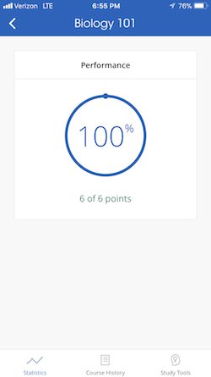
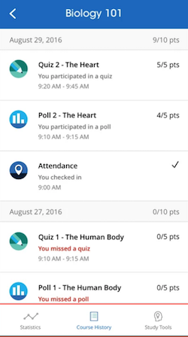
Track your performance and attendance after class
The main screen of Reef shows your Course Statistics. Here you can access a detailed overview of your course performance for polls and/or quizzes. You will also see an overview of your attendance.
The Course History provides a detailed view of your individual session results, by date. You can select an individual session to view more details, [including results and images of polling questions to use as a study guide].

Slide 11
Questions or Trouble Registering? Visit iclicker.com/support to submit a support ticket and contact the tech support team.
I have also added these steps and links to helpful troubleshooting guides for iClicker Reef in the syllabus.

